Slide 1
Software Quality Assurance and Testing
Lecture -04
Harish Aggarwal

Slide 2
Re-Cap
Lecture - 01
Definitions – S/W Quality, S/W Quality Assurance
Importance of QA
Causes of Defects
Business Models in S/W
S/W Cost, Quality Cost
Quality culture
Lecture - 02
Software Quality Models
McCall, IEEE 1061, ISO 25000 Series
Quality Requirements
Quality of Requirements
Frameworks
ISO/IEC/IEEE 12207 - Software Life Cycle Processes
Lecture - 03
Frameworks
CMMI-Development
ITIL Framework
Other Frameworks

Slide 3
Agenda
Software Quality Factors
Quality Attributes
Functional Suitability
Performance Efficiency
Compatibility
Usability
Reliability
Security
Maintainability
Portability

Slide 4
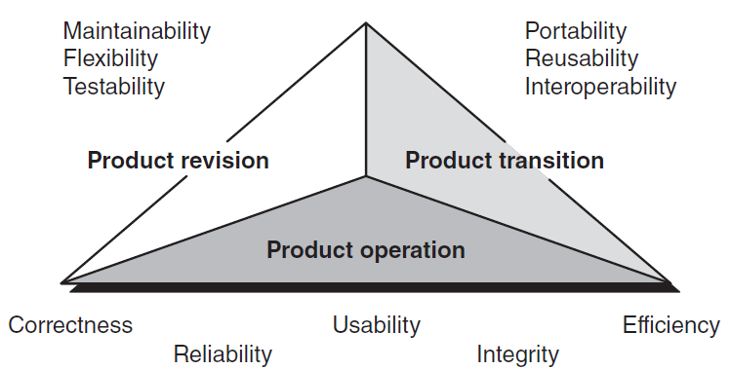
Quality Models –
McCall [MCC 77]
McCall [MCC 77] Quality Model
Perspective → Into Quality Factor → Quality criteria (Measurable).

Slide 5
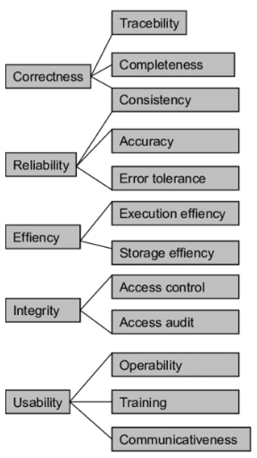
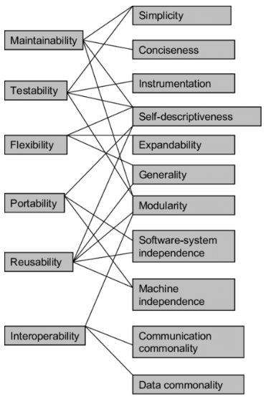
Quality Models –
McCall [MCC 77]

Slide 6
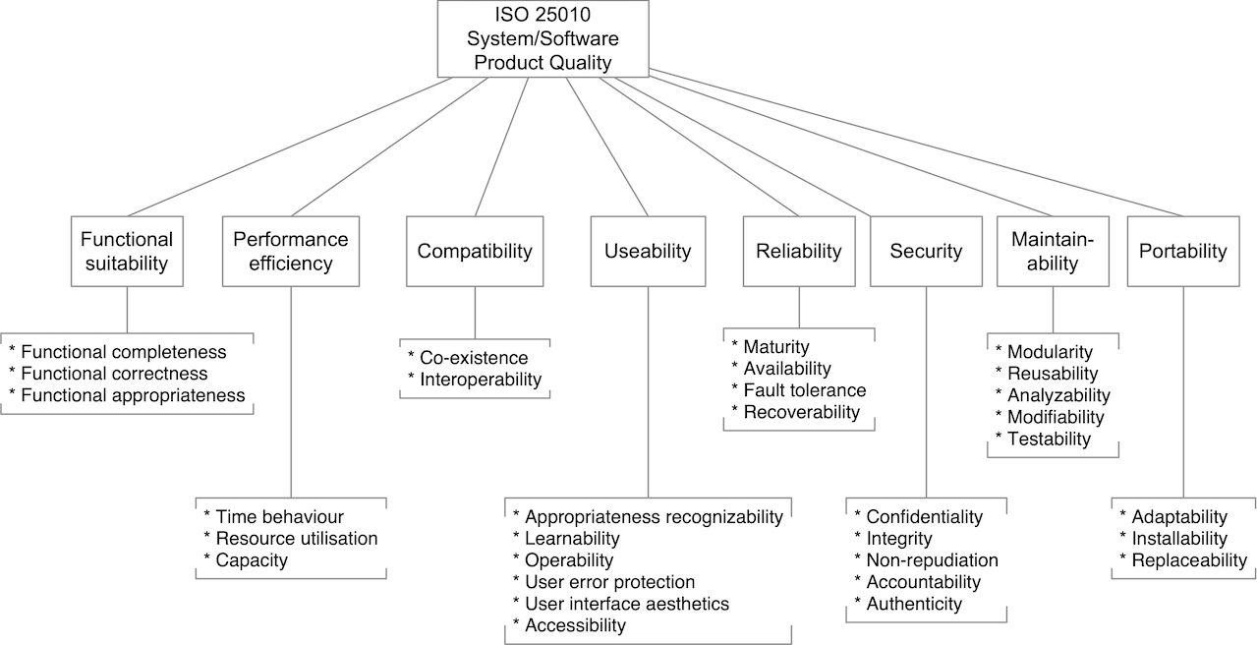
ISO 25010

Slide 7
1. Functional Suitability
Functional Suitability - Capability of a product to provide functions that meet stated and implied needs of intended users when it is used under specified conditions
Functional completeness - Capability of a product to provide a set of functions that covers all the specified tasks and intended users’ objectives.
All functionality implemented as per requirements. No requirements should be left out.
To verify that each functionality is present in the system, every requirement should be traceable through Testing.
Data should not be missing. Example in reports, etc

Slide 8
Functional Suitability
Functional Correctness - Capability of a product to provide accurate results when used by intended users.
Inaccuracy in calculations. Rounding off errors
Data should be up-to-date. No stale data. Duration of data should be accurate.
Standards for coding and documenting the software system.
Functional Appropriateness - Capability of a product to provide functions that facilitate the accomplishment of specified tasks and objectives.
A user is only presented with the necessary steps to complete a task, excluding any unnecessary steps.

Slide 9
2. Performance Efficiency
Performance Efficiency - Capability of a product to perform its functions within specified time and throughput parameters and be efficient in the use of resources under specified conditions.
Resources can be CPU, memory, storage, and network devices.
Resources can include other software products, the software and hardware configuration of the system, energy, and materials (e.g. print paper, storage media).
Time Behaviour - Capability of a product to perform its specified function under specified conditions so that the response time and throughput rates meet the requirements.
Time it takes to perform an operation.
Refresh rate of screen.
Time taken for background operations.

Slide 10
Performance Efficiency
Resource Utilization - Capability of a product to use no more than the specified amount of resources to perform its function under specified conditions.
Memory usage
Disk usage
Network Bandwidth usage
In a multi user environment, one single application should not consume all the resources
Capacity - Capability of a product to meet requirements for the maximum limits of a product parameter
Parameters can include the number of items that can be stored, the number of concurrent users, the communication bandwidth, the throughput of transactions, and the size of a database.

Slide 11
3. Compatibility
Compatibility - Capability of a product to exchange information with other products, and/or to perform its required functions while sharing the same common environment and resources.
Co-existence - Capability of a product to perform its required functions efficiently while sharing a common environment and resources with other products, without detrimental impact on any other product.
Multiple apps working simultaneously on the same operating system
Sharing same Memory, Disk, etc
Interoperability - Capability of a product to exchange information with other products and mutually use the information that has been exchanged
Information is meaningful data; and information exchange includes transformation of data for exchange.
There can be protocols for data conversion.

Slide 12
4. Usability
Usability - Degree to which a product or system can be used by specified users to achieve specified goals with effectiveness, efficiency and satisfaction in a specified context of use.
Appropriateness recognizability - Degree to which users can recognize whether a product or system is appropriate for their needs.
Time needed to understand the software functionality.
Finding an Excel formula and understanding its usage for a particular task.
Learnability - Degree to which a product or system can be used by specified users to achieve specified goals of learning to use the product or system with effectiveness, efficiency, freedom from risk and satisfaction in a specified context of use.
Time needed to learn to use
Similar operation under same menu.

Slide 13
4. Usability
Operability - Attributes that make it easy to operate and control.
Number of steps needed to achieve a certain functionality.
User error protection - Protects users against making errors.
Error messages and warnings for wrong usage (Warning message before deleting any file)
Completely stop users to perform certain functions which can send system into unusable state. (Cannot delete system files - Only view them)

Slide 14
4. Usability
User interface aesthetics - User interface enables pleasing and satisfying interaction for the user.
Configurable Color themes
Rounded button Vs Square buttons Vs Square buttons with rounded corners
Accessibility - Degree to which a product or system can be used by people with the widest range of characteristics and capabilities to achieve a specified goal in a specified context of use.
System can be used by, “Specially Abled” people
Big font size for old age people
Voice conversion for written text.

Slide 15
5. Reliability
Reliability - Degree to which a system, product or component performs specified functions under specified conditions for a specified period of time.
Deals with failure to provide service.
Failure rate could refer to a component or system as a whole.
Maturity - Degree to which a system meets needs for reliability under normal operation.
MS Teams meeting - Voice clarity under normal circumstance.
Availability - Degree to which a system, product or component is operational and accessible when required for use.
Controlling downtime caused due to maintenance, breakdown, etc

Slide 16
5. Reliability
Fault tolerance - Degree to which a system, product, or component operates as intended despite the presence of hardware or software Faults.
RAID configurations - Read and write across multiple disks. Mirroring data sets across multiple disks, which makes RAID systems more fault tolerant by creating built-in data redundancy.
Recoverability - Degree to which, in the event of an interruption or a failure, a product or system can recover the data directly affected and re-establish the desired state of the system.
Power goes off in the meeting and is back in a minute. Meeting is restarted automatically. All the people do not have to join the meeting again.
Slight disruption in Wi-Fi. Status of meeting does not changes

Slide 17
6. Security
Security - Degree to which a product or system protects information and data so that persons or other products or systems have the degree of data access appropriate to their types and levels of authorization.
Confidentiality - Degree to which a product or system ensures that data are accessible only to those authorized to have access.
Only authorized users can access the data
Login/Pwd for users.
E.g. People not in this course cannot access any material related to this course
Integrity - Degree to which a system, product or component prevents unauthorized access to, or modification of, computer programs or data.
Only authorized users do certain operations on the data.
E.g. Only instructor can add/delete in Files section

Slide 18
6. Security
Non-repudiation - Degree to which actions or events can be proven to have taken place so that the events or actions cannot be repudiated later.
E.g. If files gets deleted in the system, it can be proven that the file did get deleted.
Versioning in files maintain all the changes happening in the file.
Accountability - Degree to which the actions of an entity can be traced uniquely to the entity.
Logs and traces in the system to track as to who performed any action
Authenticity - Degree to which the identity of a subject or resource can be proved to be the one claimed.
Can be done using certifications, encryption.
No change can be done to document and also it can be proved as to who did it.

Slide 19
7. Maintainability
Maintainability - This characteristic represents the degree of effectiveness and efficiency with which a product or system can be modified to improve it, correct it or adapt it to changes in environment, and in requirements.
Modularity - Degree to which a system or computer program is composed of discrete components such that a change to one component has minimal impact on other components.
Easy to do change management.
Object oriented programing.
Reusability - Degree to which an asset can be used in more than one system, or in building other assets.
Libraries, DLLs

Slide 20
7. Maintainability
Analyzability - Degree of effectiveness and efficiency with which it is possible to assess the impact on a product or system of an intended change to one or more of its parts, or to diagnose a product for deficiencies or causes of failures, or to identify parts to be modified.
Helps in bug fixing, new feature development
Modifiability - Degree to which a product or system can be effectively and efficiently modified without introducing defects or degrading existing product quality.
Able to get confidence in quality with minimal regression testing
Testability - Degree of effectiveness and efficiency with which test criteria can be established for a system, product or component and tests can be performed to determine whether those criteria have been met.
Design test cases corresponding to requirements and able to test the system using those Test Cases

Slide 21
8. Portability
Portability - Degree of effectiveness and efficiency with which a system, product or component can be transferred from one hardware, software or other operational or usage environment to another. This characteristic is composed of the following sub-characteristics:
Adaptability - Degree to which a product or system can effectively and efficiently be adapted for different or evolving hardware, software or other operational or usage environments.
New Driver for newer Printer, Audio device, etc
Newer version of Apps corresponding to newer operating system

Slide 22
8. Portability
Installability - Degree of effectiveness and efficiency with which a product or system can be successfully installed and/or uninstalled in a specified environment.
New software
Patches, New Features
Service Packs
Newer versions.
Replaceability - Degree to which a product can replace another specified software product for the same purpose in the same environment.
IE, Chrome, Firefox
Mail clients

